Slide 1
Classification
10/21/2019
Check-in: http://bit.ly/33PIGmF
Pin: 630521

Slide 2
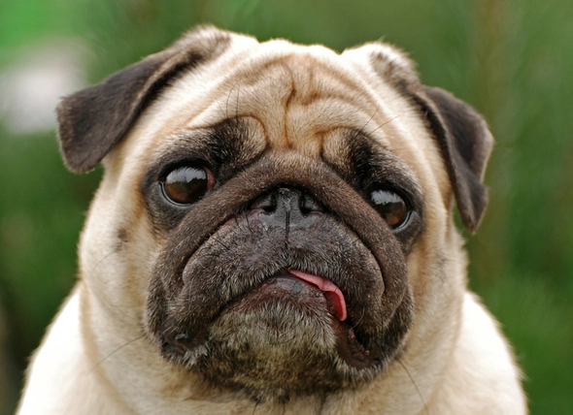
Input (X)
Discrete
Continuous
Output (Y)
Discrete
Ordinal
Categorical
Integer
P(Dog | X) = 0.9
P(Cat | X) = 0.1
P(Mouse | X) = 0.1
Classifier f : x → y
Dog

Slide 3
Discriminative vs Generative
Discriminative
Learn the differences in properties best separate the data
Find the closest match with the highest conditional probability
Generative
Learn the properties of each classes (labels) seen
Compare and find the closest match

Slide 4
Discriminative vs Generative
Discriminative
Assume a model/function for P(y | x)
Train with data to estimate P(y | x)
Given new data, use P(y | x) to predict/map the correct label/class
Generative
Assume models/functions for P(x | y) and P(y)
Train with data to estimate P(x | y) and P(y)
Use Bayes Theorem to calculate P(y | x) = P(x | y) * P(y) / P(x)
Given new data, use P(y | x) to predict/map the correct label/class

Slide 5
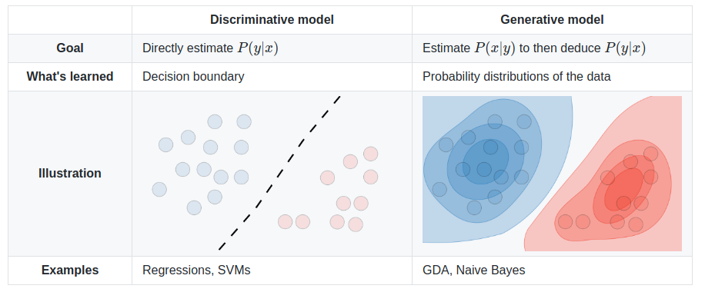
Discriminative vs Generative
Discriminative
Generative

Slide 6
Discriminative vs Generative
Discriminative
‌Logistic regression
Support Vector Machine
‌Traditional neural networks
‌Nearest Neighbors
Generative
Naïve Bayes
Bayesian networks
Markov random fields
‌Hidden Markov Models (HMM)

Slide 7
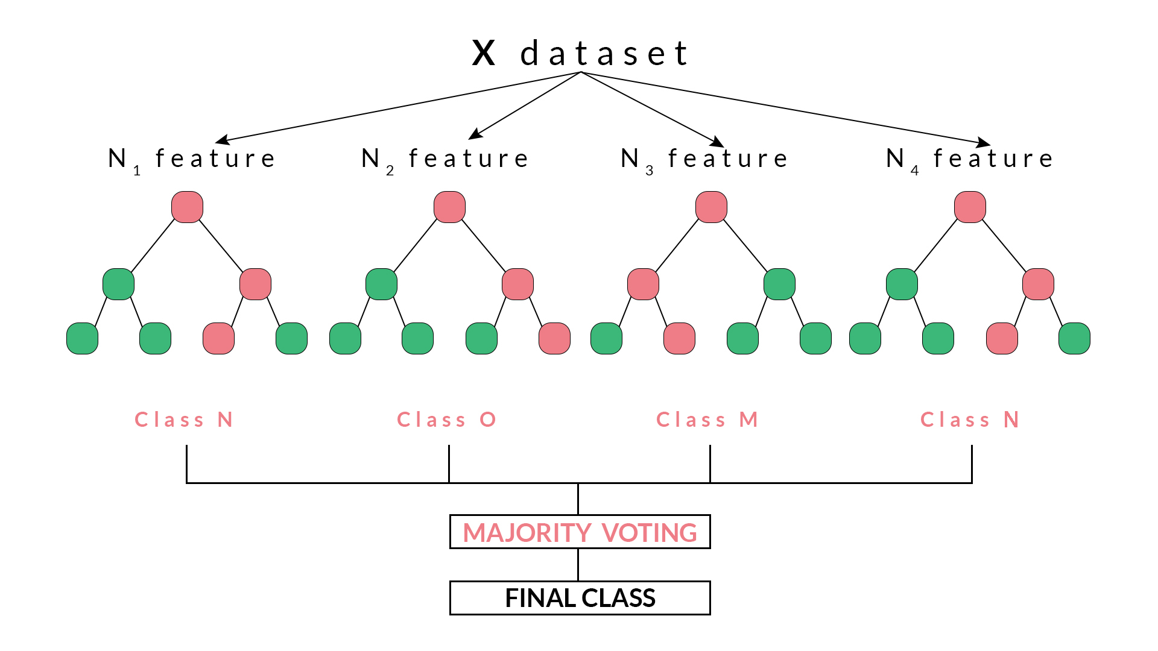
Generative or Discriminative?

Slide 8
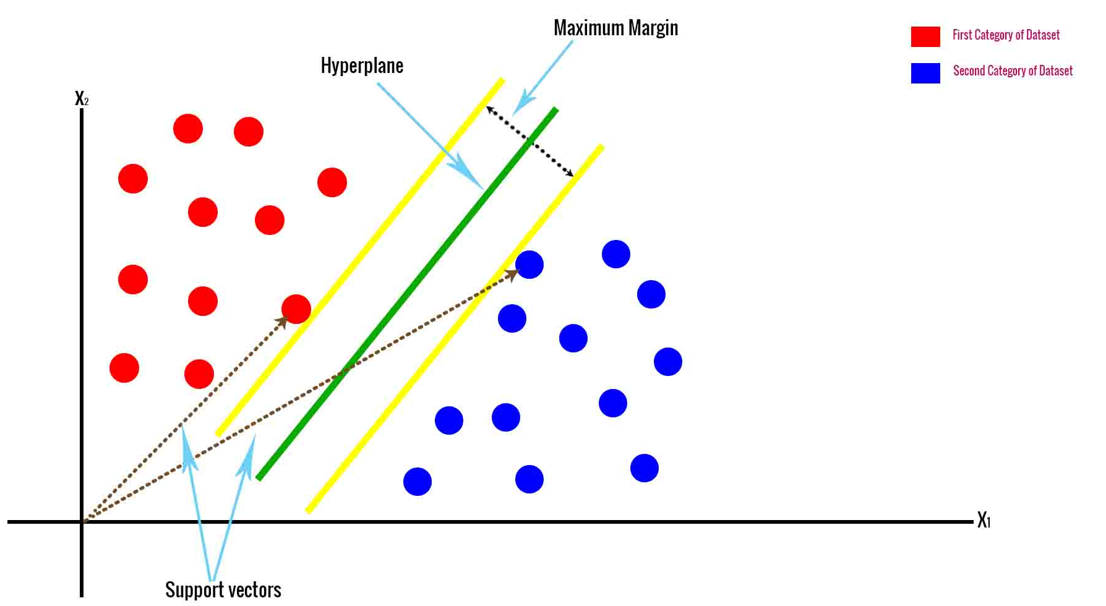
Generative or Discriminative?

Slide 9
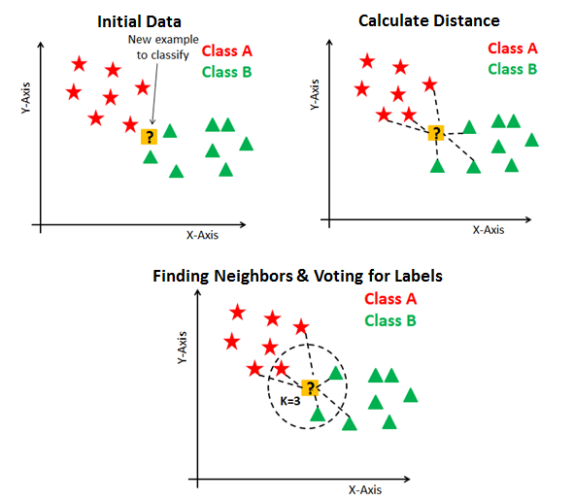
Generative or Discriminative?

Slide 10
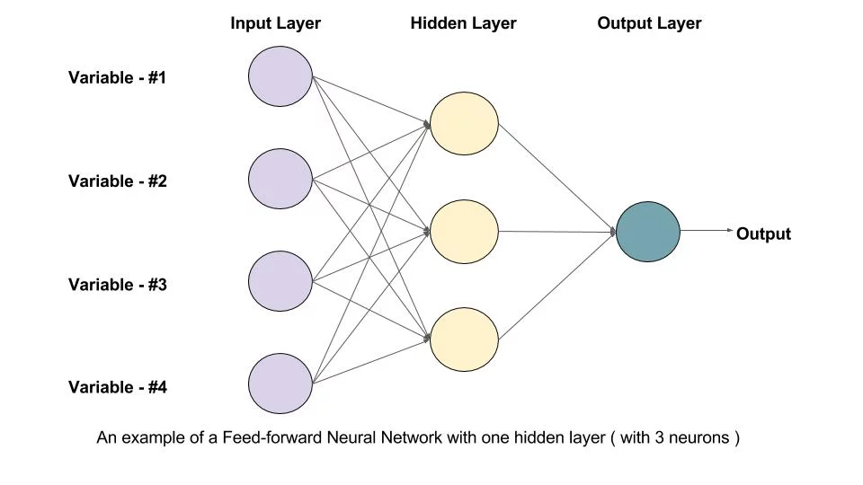
Generative or Discriminative?

